Slide 1

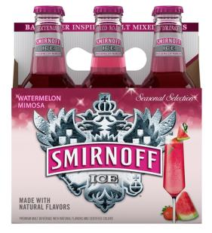



Smirnoff watermelon mimosa – INNOV Permanent sku
SITUATION
  Smirnoff Ice, the pioneer of credible and delicious mixed drinks, has created a new sparkly, celebratory malt-based cocktail line . This is the third Variant in the seasonal line following the launch of SI Peach Bellini and Sparkling Crisp Apple. Smirnoff Ice Sparkling Malt Mixed Drinks are crafted with the freshest fruit flavors and perfect amount of sparkle.
IDEA
  These new drinks deliver a premium taste experience with the perfect balance of flavor, sweetness, alcohol, and a little extra carbonation. Not too sweet or overly flavored. Watermelon Mimosa is a refreshing mixture of Prosecco, Watermelon and Berry Flavors.
HOW IT WORKS
Premium Malt Beverage. 5.8% ABV
Available wherever premium beer is sold. Suggested PTC equal to
current Smirnoff Ice pricing per 6-pack of 11.2oz bottles also available in 24oz Bopper.
Targeted Retail Timing: Permanent SKU Apr/May
Targeted 1st Ship: Mar 2015
BOTTLE UPC
CARTON UPC
SHIPPER UPC

Slide 2
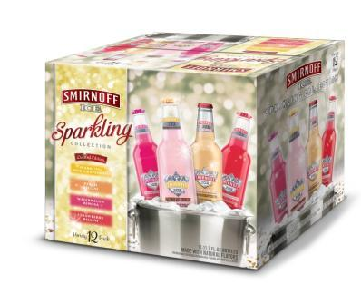
Smirnoff ice sparkling 12 pack – SEASONAL
Opportunity:
Female consumers seek value and variety—The Smirnoff Ice party pack is a proven off-premise proposition to sample target consumers with multiple flavors at a value price point
Featuring Sparkling Pink Grapefruit: grapefruit is HOT and Summer is the season for This Growing Cocktail
The Pack:
Smirnoff Ice® Peach Bellini
Smirnoff Ice® Strawberry Bellini
Smirnoff Ice® Sparkling Watermelon Mimosa
NEW! Smirnoff Ice® Sparkling Pink Grapefruit
Target 1st Ship: week of Mar 9, 2015
Target Retail Timing: Apr/May
Same UPC as Pack with Moscow Mule

